Slide 2
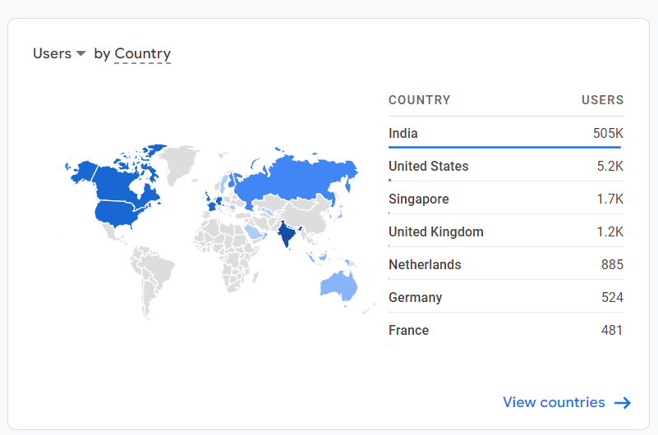
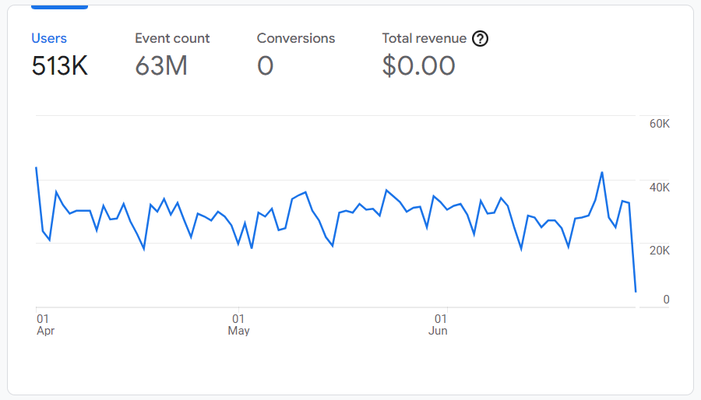
We Build Globally Scalable Solutions
Volume of users used the application from 1st Apr to 30 Jun 2022

Slide 3






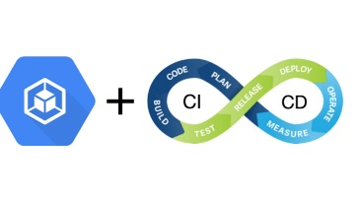






A Developer Lifestyle

Slide 4
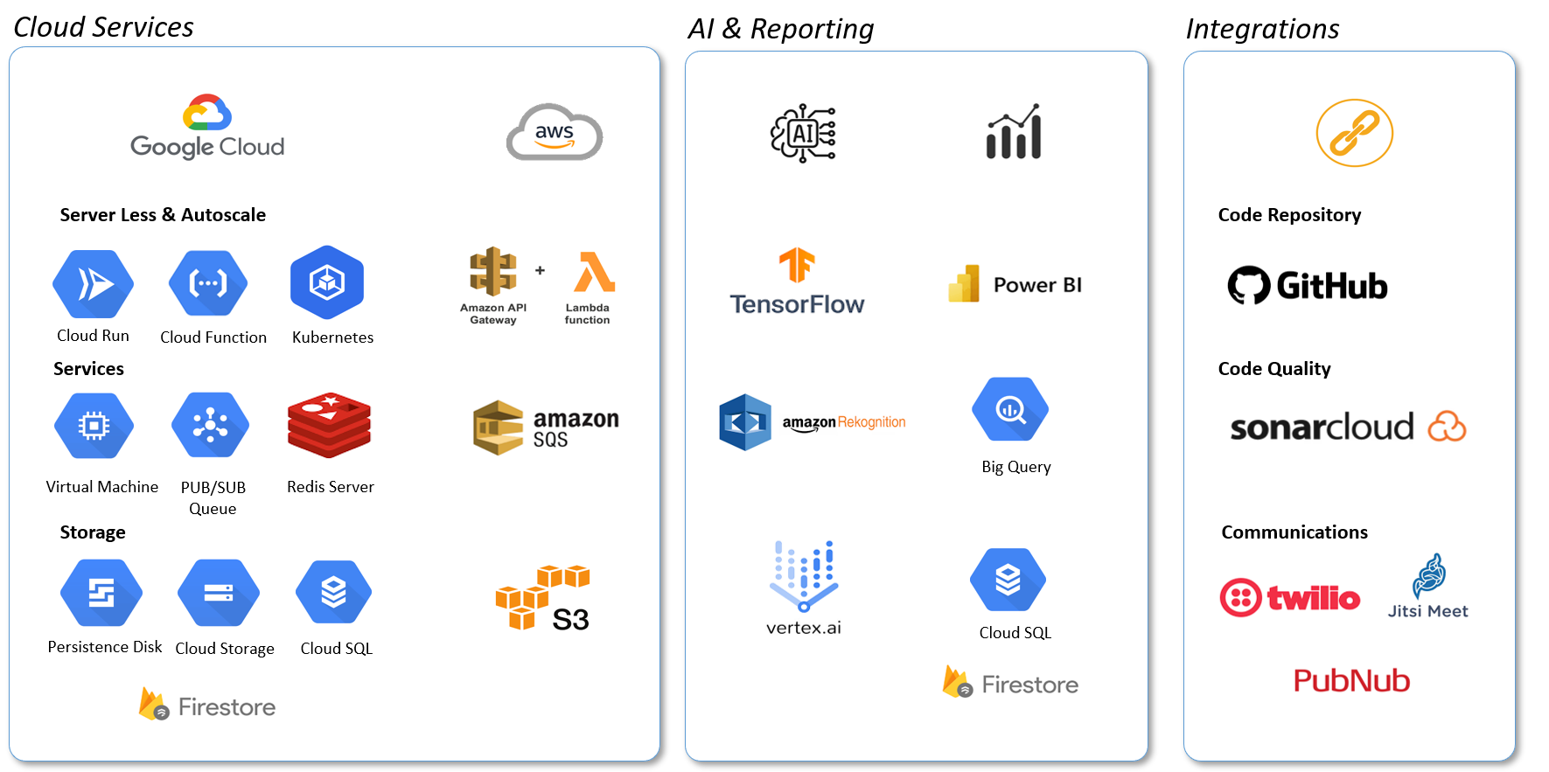
We Build For Scale - Cutting Edge Tools

Slide 5
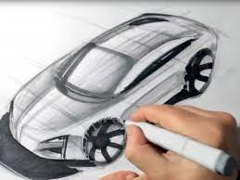
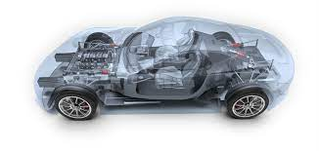
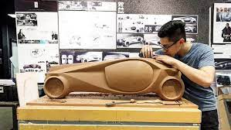
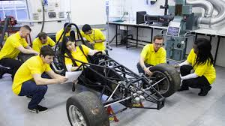
What is your strength?
Frontend Engineer
Backend Engineer
Full Stack

Slide 6
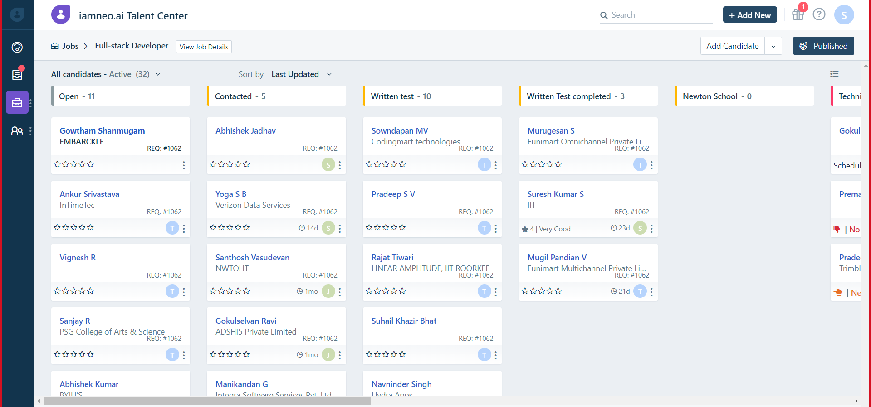
Frontend Usecase To Build
1
1. Build UI replica of the attached image using Angular (or) React (or) Vue.js (or) etc.
https://randomuser.me/
2. Enable drag and drop of the cards with reference's like:
https://github.com/atlassian/react-beautiful-dnd
3. Build search functionality
4. Make it mobile responsive using Bootstrap (or) Material UI (or) any npm UI package etc.

Slide 7
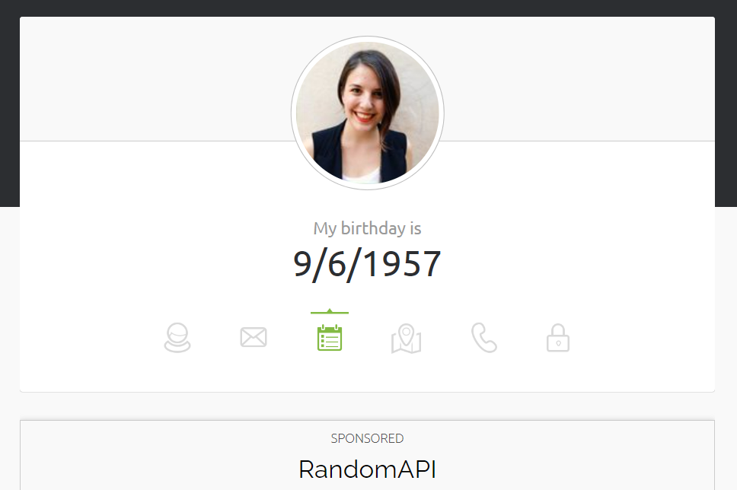
Backend Usecases
1
1. Build API which store atleast 10,000 users data similar to https://randomuser.me/
2. API’s should support all CRUD operations
3. Search capability using Image, Name, Email, Phone, DOB, Location, Gender, Address
4. Associate Swagger API documentation (&) coding to follow SOLID Principle

Slide 8
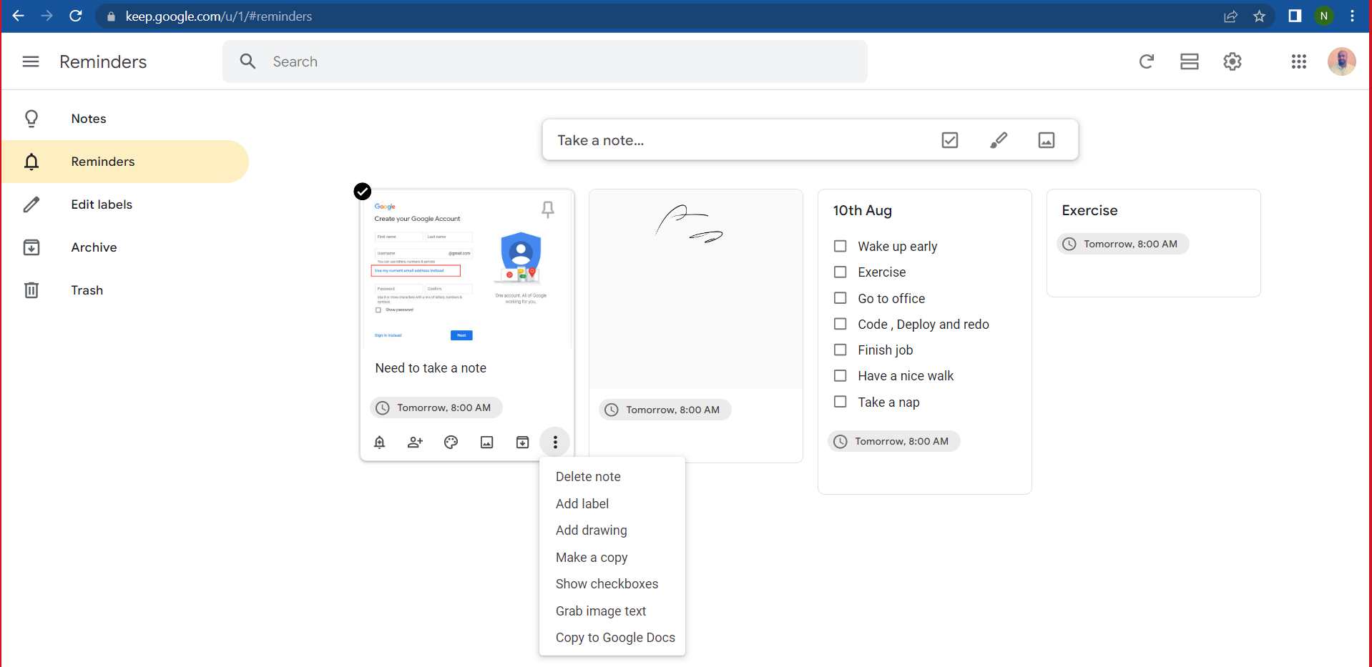
Frontend Usecase To Build
2
1. Build a To-Do application similar to https://keep.google.com/
2. Enable drag and drop of the list items within the card
3. Build CRUD operations using local data storage

Slide 9
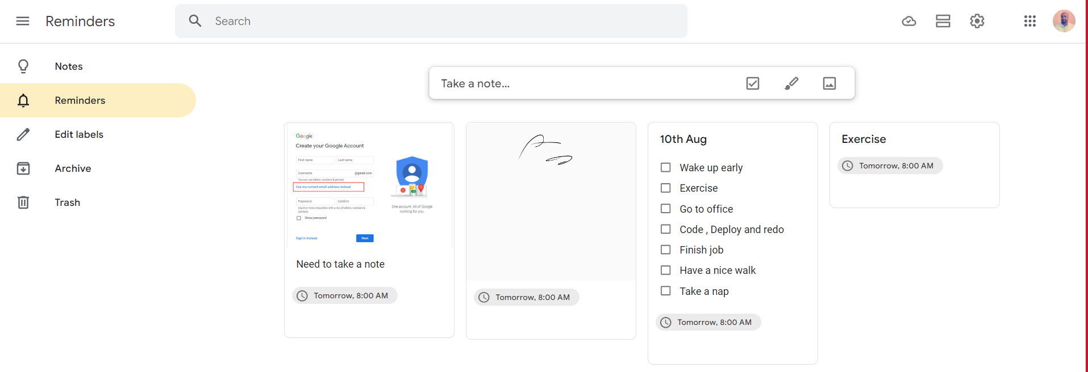
Backend Usecases
2
1. Build API which store To-Do (Image, Plain Text, List, Tags) list similar to https://keep.google.com/
2. API’s should support all CRUD operations
3. API’s should support search using Tags, Notes, Text
4. Associate Swagger API documentation (&) coding should follow SOLID principles

Slide 10




What we expect in 3 days ?
Build the required application and maintain source code at
Ensure the source code quality is tested using
Host your frontend (or) backend application at

Slide 11
Thank You

